Slide 1
BLOOD DONATION MANAGEMENT SYSTEM
“Donate blood and be the reason of smile to many faces”

Slide 2

MINI PROJECT BY
NAMES ROLL NO
DEEPAK MISHRA 44
OMKAR CHAUHAN 11
SATYAM MAURYA 41
HRITIK MISHRA 45

Slide 3
PROJECT PROFILE
SR NO. | CONTENTS | DETAILS
1 | Project Name | Blood Bank Managemant System
2 | Objective | The system provide online information of blood bank and administrators can also all information about blood bank,donor,patient request and blood requriments.
3 | Platform | Web application
4 | Front End | Pycharm
5 | Back End | SQL
6 | Internal Guide | Hasib shaikh
7 | Department | Computer

Slide 4
EXISTING SYSTEM
Existing system is window Application.
So much time consuming this application also one machine and one by one record stored.
Single Blood bank information also no inquiry for directly Blood bank.

Slide 5
NEED FOR NEW SYSTEM
• User view all Blood bank information is location
wise.
• Donor easily donate the blood near Blood bank
Location.
• Patient easily request for blood near Blood bank
location
• In this system also supported inquiry form for user.

Slide 6
FUNCTION SPECIFICATION
Admin
• Manage Registration for user
• Manage Blood bank information like (update, delete)
• Manage Donor Request for Donor
• Manage patient Request for needy people
• Manage Inquiry form for Appropriate Reply
• Manage feedback for Appropriate Reply
BLOOD BANK
• Blood bank information view/update
• View Donor information
• Manage Patient Blood Request.

Slide 7
DONOR
• Manage Donor information(profile)
• Add new Donation for Blood
PATIENT
• Manage patient information(profile)
• Give the Request for patient for blood

Slide 8
HARDWARE & SOFTWARE SPECIFICATION
Hardware Specification :
Server Side:
Processor | 3.6 GHz
RAM | 2 GB
Hard Disk | 80 GB
Client Side:
Processor | 2.40 GHz
RAM | 1 GB
Hard Disk | 20 GB

Slide 9
Software Specification : • Server Side
Operating System | System Window Server 2008 Runtime Environment .
Runtime Environment
Web Server
Front End
Back End
• Client Side
Operating System | Windows XP or any compatible OS
Web Browser | Internet Explorer 6.0 or any compatible web browser

Slide 10
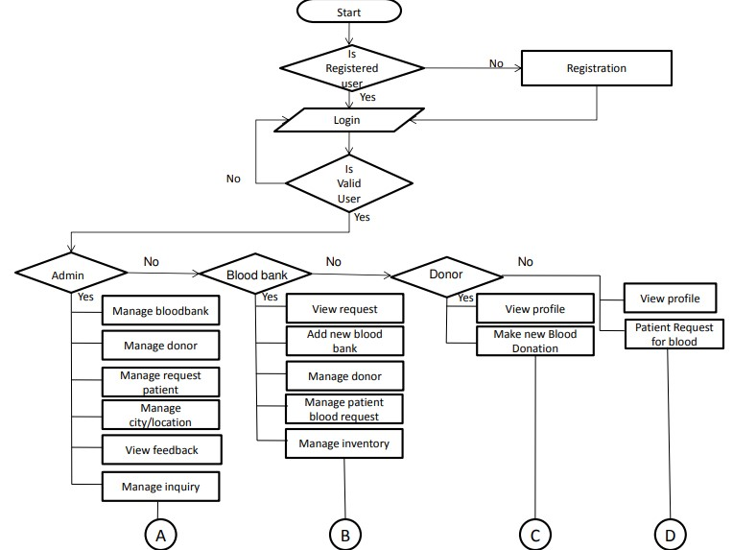
FLOW CHART

Slide 11
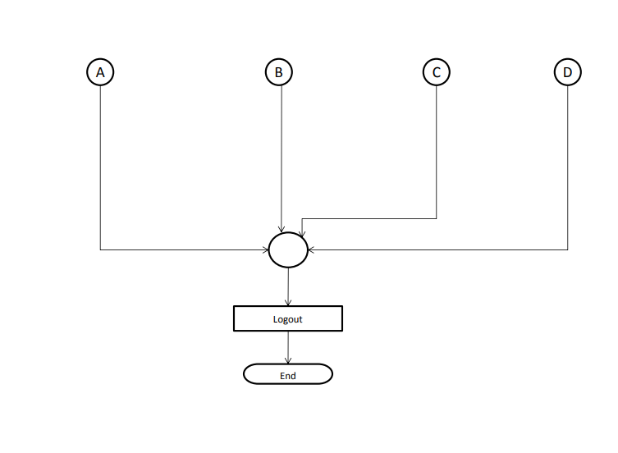

Slide 12
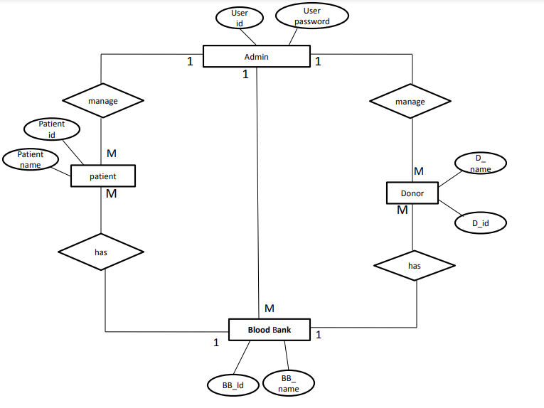
ER DIAGRAM

Slide 13
THANK YOU

